Slide 1


CHATBOT WITH WATSON

Slide 2
ABSTRACT
Chatbot is used to conversation with users , when we give what ever the question it will instantly replay the answer.
And it is helping to purchasing product, current updates and etc....
We want to create a Chatbot by using the Watson assistant
Chatbot to assist users on popular messaging platforms like Facebook Messenger and Slack
Let’s we see about how to create chatbot using Watson under the slides

Slide 3
PROBLEM DEFINITION
The project involves creating a chatbot using IBM Cloud Watson Assistant. The goal is to develop a virtual guide that assists users on messaging platforms like Facebook Messenger and Slack. The chatbot should provide helpful information, answer frequently asked questions (FAQs), and offer a friendly conversational experience. The project includes designing the chatbot's persona, configuring responses, integrating with messaging platforms, and ensuring a seamless user experience.

Slide 4

DESIGN THINKING.

Slide 5
PERSONA DESIGN:
Persona Design: name “Sonychat”," embodies a persona that tone ,voice and personality of your virtual assistant associated with IBM's Watson technology with a friendly to the user.
Tone : SonyChat tone like friendly, professional, witty based on our brand values and target audience.
Style: Its style of voice and language are unique, clarity and a commitment to providing accurate information.

Slide 6
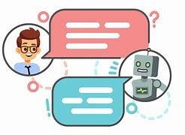
USER SCENARIOS
A chatbot powered by Watson can be designed to address a wide range of user scenarios and frequently asked questions (FAQs) across various domains.
It use machine learning technology and natural language pocessing to identify common user scenarios and FAQs that the chatbot should be able to address
It is used to resolve what ever the problem ,error or any questions it give accurate answer

Slide 7
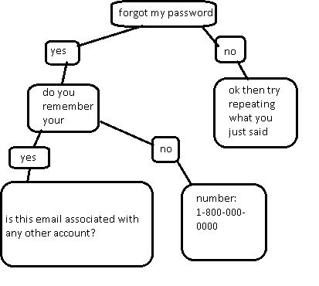
CONVERSATION FLOW
Conversation flow: a chatbot powered by Watson involves creating a structure of our chatbot conversational flow.
Start with a greeting message, ask a question, provide multiple choices for answers, and mockup what your chatbot will say in response to each answer.
Chatbot able to handle various type of question format like program,text,image,etc...
Five steps for creating conversational flow:Greetings, Asking, Suggestions, Failure and End

Slide 8
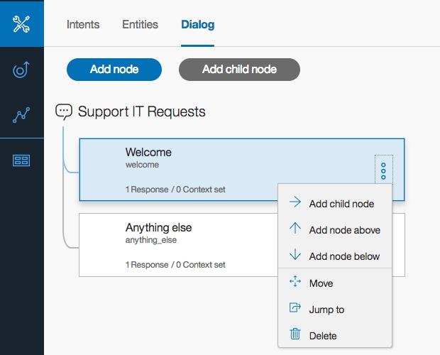
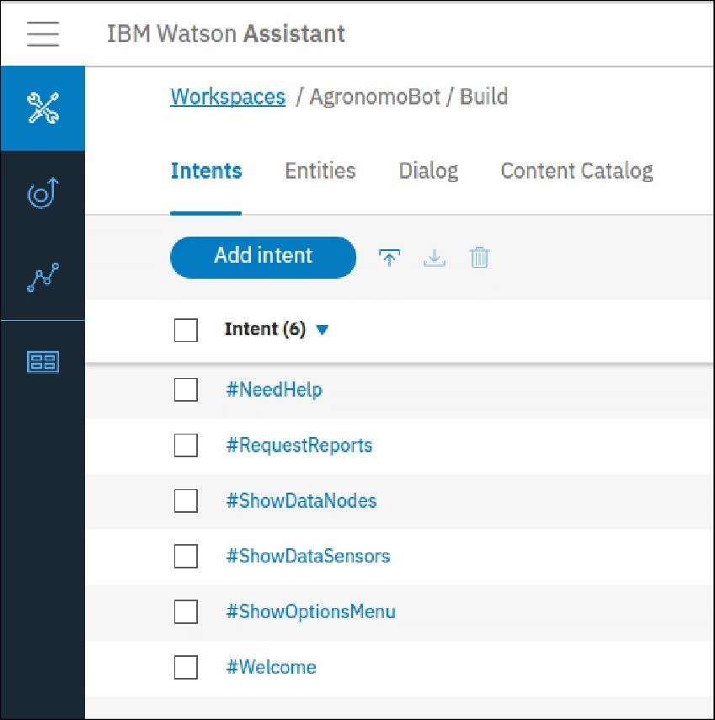
RESPONSIBLE CONFIGURATION
chatbot using Watson Assistant it involves intents,entities and dialog nodes
Intents:An intent represents the purpose of a user's input. You define an intent for each type of user request you want your application to support.
Entity: An entity represents a term or object that is relevant to your intents and that provides a specific context for an intent. You list the possible values for each entity and synonyms that users might enter.

Slide 9
Dialog: A dialog is a branching conversation flow that defines responses to the defined intents and entities. You use the dialog builder in the tool to create conversations with users to provide responses

Slide 10
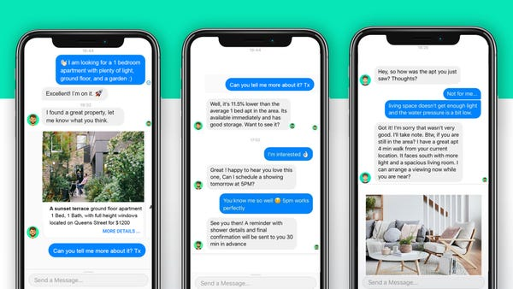
PLATFORM INTEGRATION
We use the Watson assistant to develop chatbot to Integrate with the popular messaging platforms
Now a days more of the messanger platforms are integrated with chatbot
If we integrate messanger platforms with it's for customer support, information queries, or any other purpose, users can access the chatbot effortlessly.
Using Watson assistant to develop a chatbot is integrate with the facebook messanger and slack.

Slide 11
Chatbots are integrated with various social platforms and application. Some of the platforms that chatbots can be integrated with include:Websites
Facebook messanger,Slack
Slack:
Slack is a popular communication and collaboration
platform used in various professional settings.

Slide 12

USER EXPERIENCE
User Experience: A seamless user experience refers to a smooth, intuitive, and frictionless journey that users have while interacting with a digital product. It involves delivering an experience that is easy to navigate, visually appealing, and efficient in fulfilling user needs
setting a welcoming tone for the interaction. Clear and concise prompts should guide users on how to interact with the chatbot effectively.

Slide 13

THANK YOU!

